Slide 1

Enhancing Spotify’s Recommender System Using Predictive Analytics
INFO 648 – BUSINESS DATA ANALYTICS

Slide 2


About us
Spotify is the world’s leading audio streaming subscription service, offering access to over 100 million tracks, 6.5 million podcasts, and 350,000 audiobooks. Founded in 2006 by Daniel Ek and Martin Lorentzon, Spotify launched in 2008 and now serves more than 675 million users across 184 countries, including 263 million premium subscribers.
In 2024, Spotify achieved its first full year of profitability, reporting a net income of €883 million and an operating income of €477 million in the fourth quarter. The company’s mission is to unlock the potential of human creativity by enabling a million artists to live off their art and billions of fans to enjoy and be inspired by it.

Slide 3


Introduction
Objective
Predict future hit songs to improve Spotify’s recommender system.
Scope:
Q1: Predict whether a song’s popularity score will exceed 64 (≥=65)
Q2: Optimize predictions based on revenue and cost
Q3: Explore feature patterns and clustering to support playlist curation

Slide 4
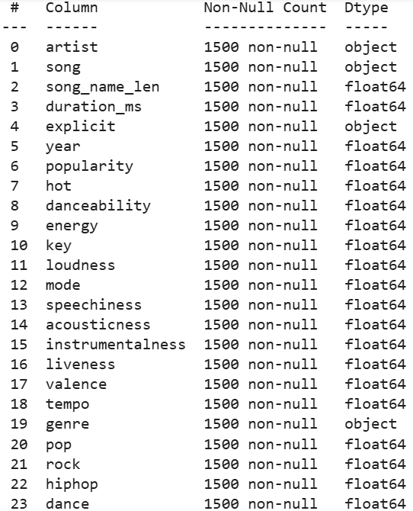
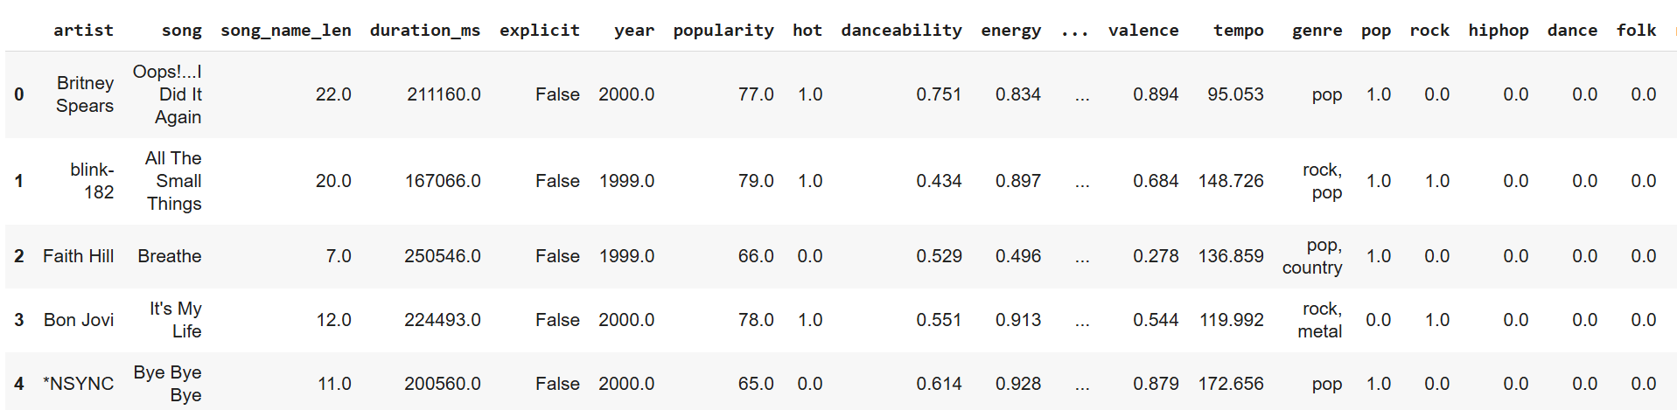
Data Overview
Dataset: 1998–2020 U.S. Spotify chart
Key Attributes: danceability, energy, valence, explicit, genre, duration_ms, etc.
Target Variable: Binary popularity (1 if ≥65, else 0)

Slide 5
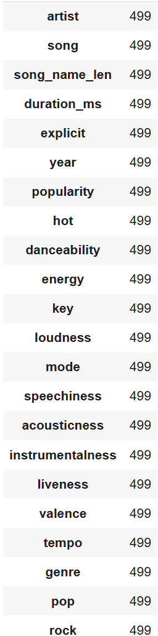
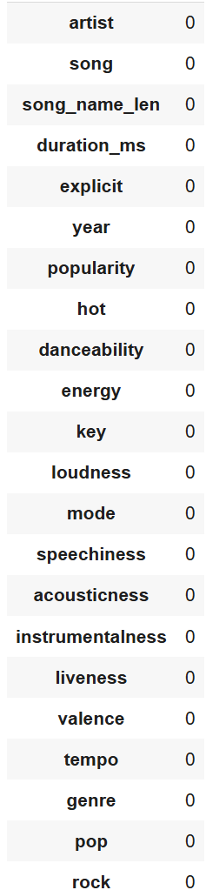
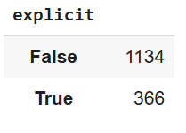
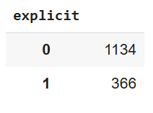
Preprocessing Summary
Removed missing values
Created binary target: popularity_binary = (popularity ≥ 65)
Identified Variable Types
Numerical Features : song_name_len, duration_ms, year, etc
Categorical Features : artist, song, explicit, genre
Encoded ‘Explicit’

Slide 6
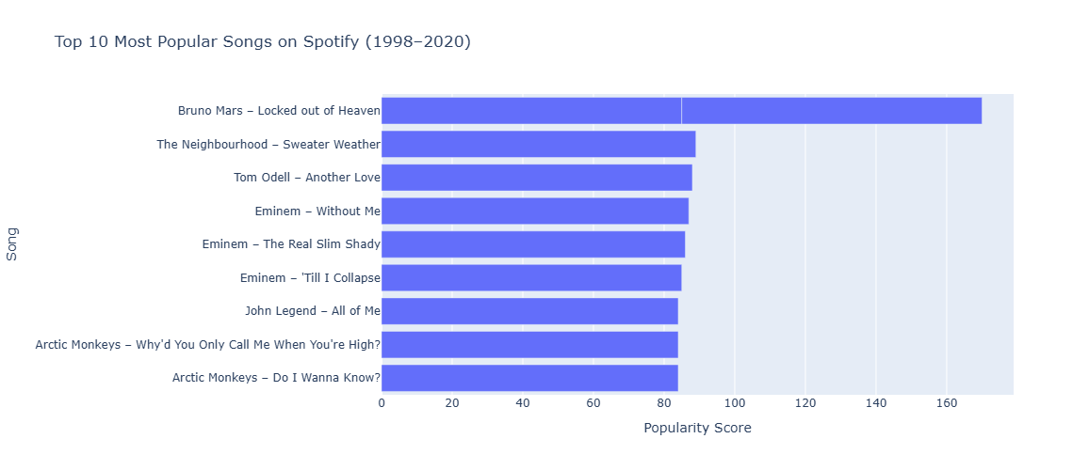
Top 10 Songs on Spotify

Slide 7
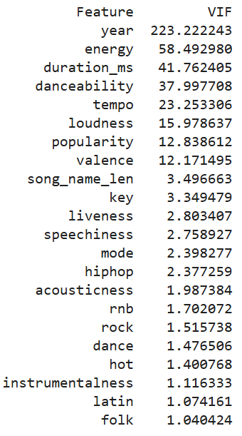
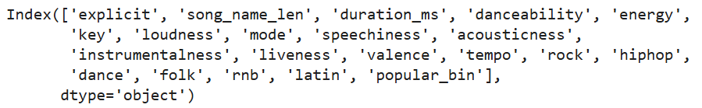
Feature Selection
Variance Inflation Factor (VIF)
Performed VIF to address multicollinearity
Dropped ‘popularity’ and ‘hot’ due to overlap with target
Removed ‘year’ for its high VIF
Finalized a reduced feature set for modelling

Slide 8
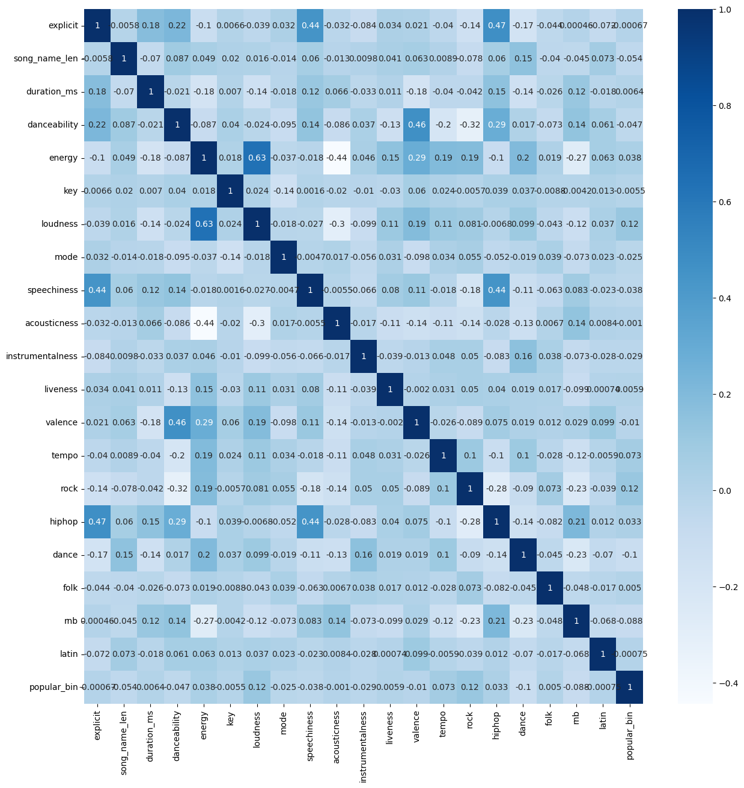
Correlation Analysis
Computed a correlation matrix to assess linear relationships
among numerical features
Most features showed weak correlations, suggesting that:
No single feature strongly predicts popularity on its own.
A combination of features is likely needed for accurate classification
Notable observations:
Slight positive correlation with danceability, valence, and hiphop.
Slight negative correlation with folk and acousticness

Slide 9
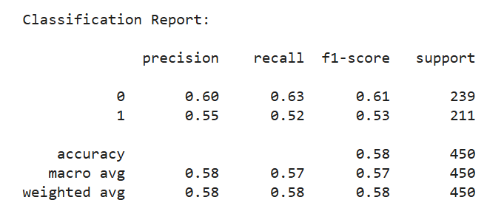
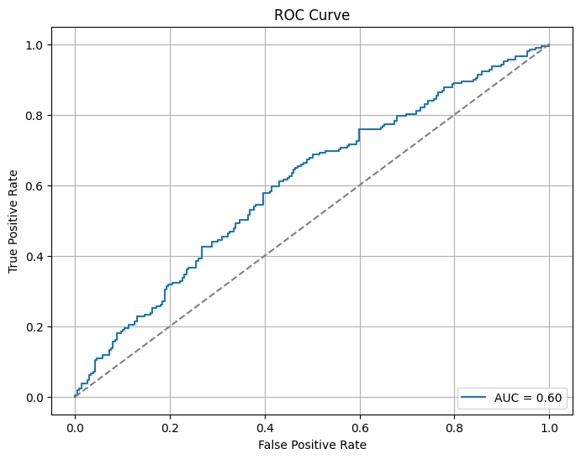
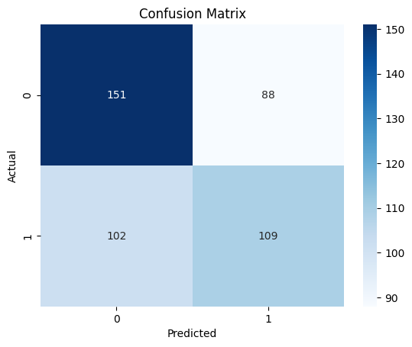
2. Sequential Forward Selection
Applied Sequential Forward Selection with Logistic Regression using AUC as the evaluation metric.
Identified optimal subset of 11 features:
explicit, song_name_len, energy, loudness, speechiness,
acousticness, tempo, rock, hiphop, dance, rnb
Achieved a Cross Validated AUC : 0.64 and a Test AUC : 0.60
Notes:
bhjhgbh

Slide 10
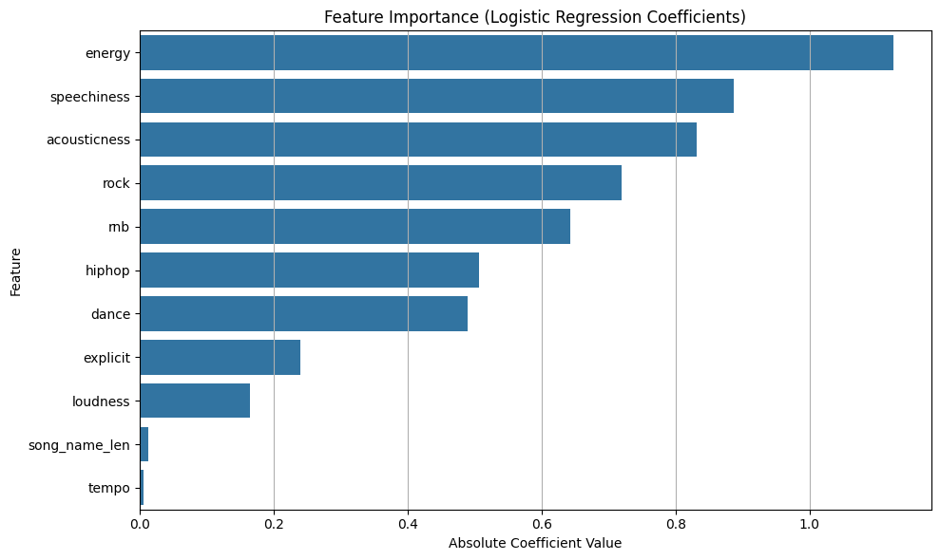
Feature Importance

Slide 11
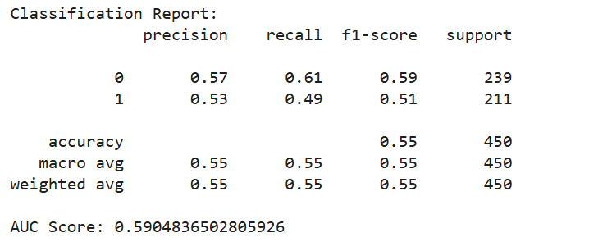
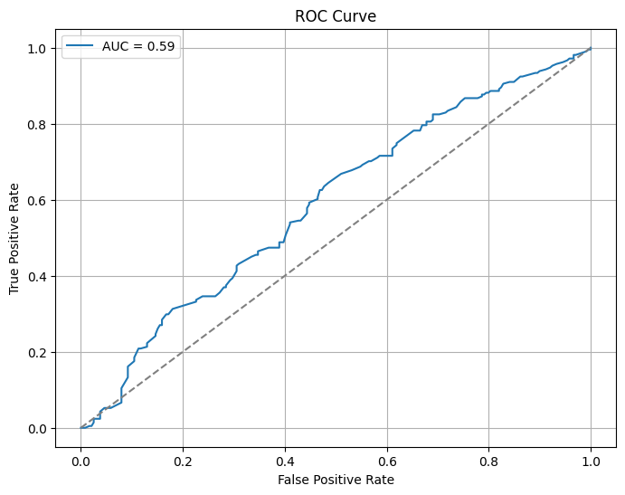
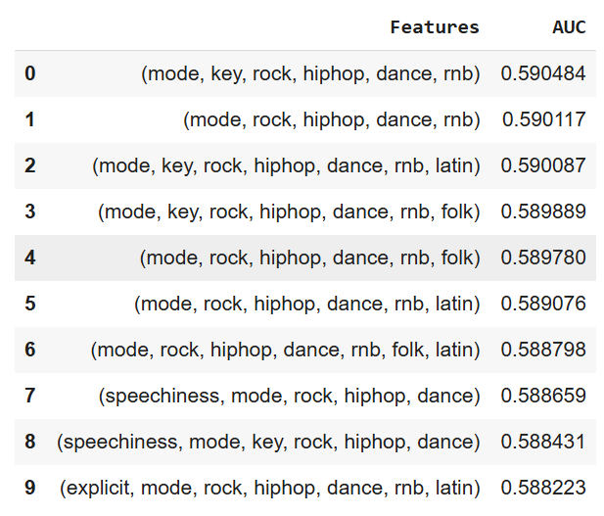
Final Feature
Combination Testing
Explored all possible combinations of 3 to 7 features from a refined candidate pool (based on VIF and prior insights) Selected Features:
['mode', 'key', 'rock', 'hiphop', 'dance', 'rnb']

Slide 12
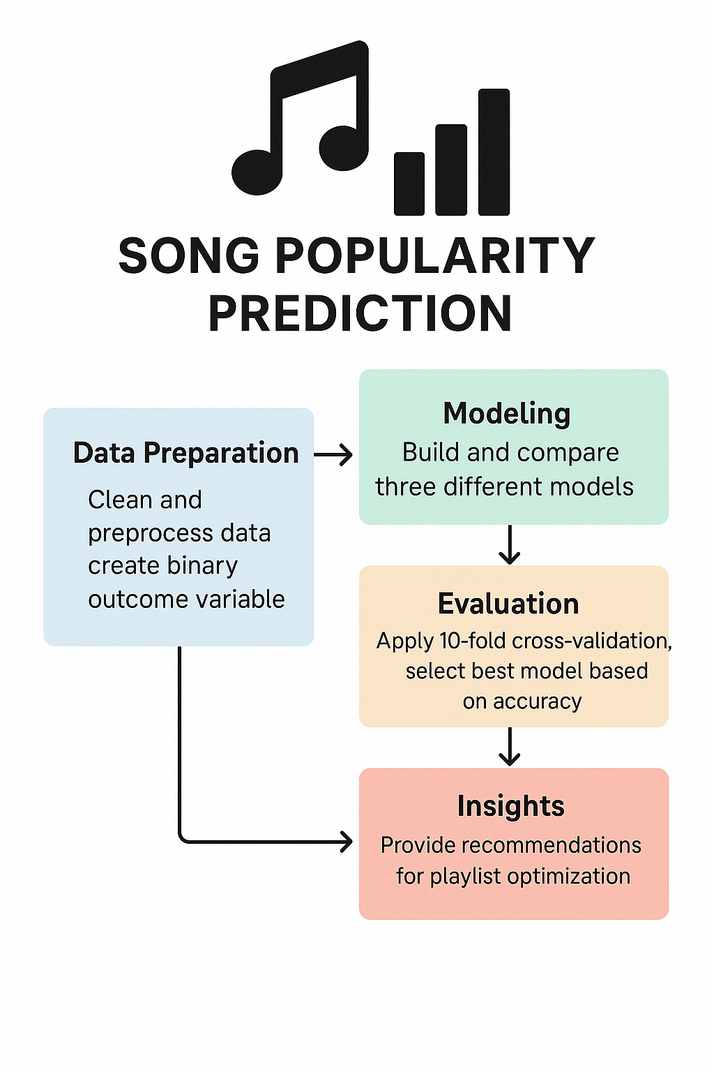
Q1: Predicting Popularity
Goal:
Predict whether a song’s popularity score will exceed 64, helping Spotify identify and recommend songs with high user engagement potential.
Modeling & Evaluation
Step 1: Models Building
Logistic Regression
Decision Tree
K - Nearest Neighbors
Step 2: 10-fold cross-validation - Applied on all the models
Step 3: Fine tuned K-Nearest Neighbors and Decision Tree
Step 4: Select the best model based on accuracy (test accuracy)

Slide 13
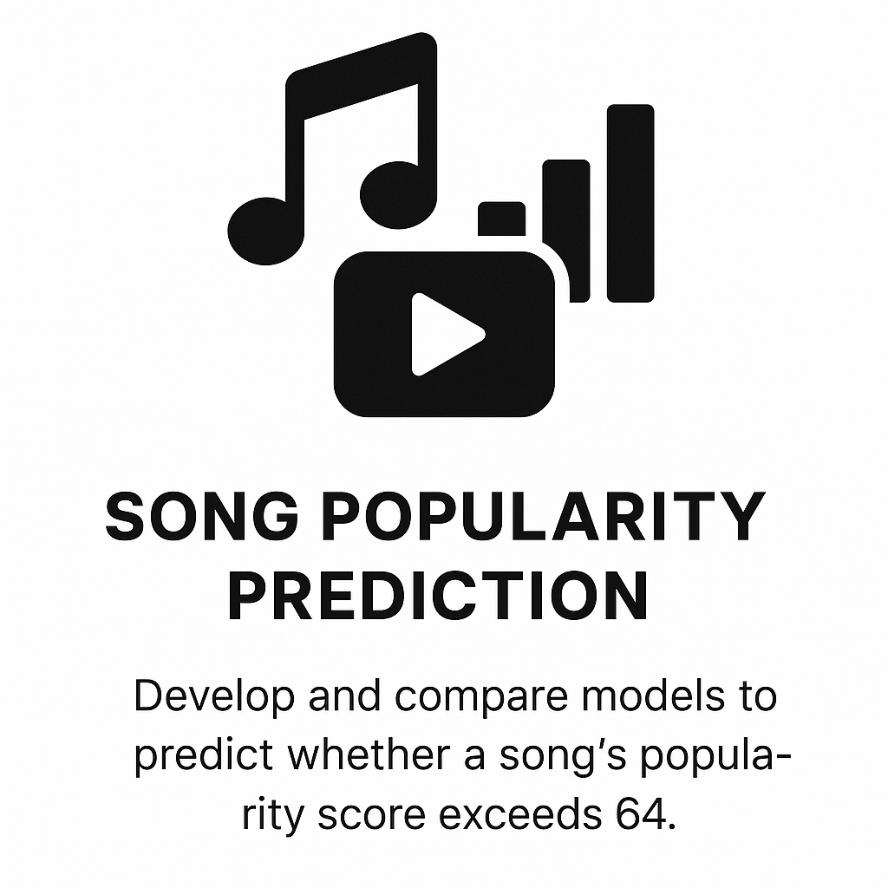
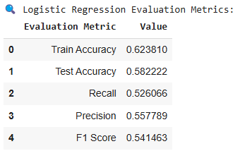
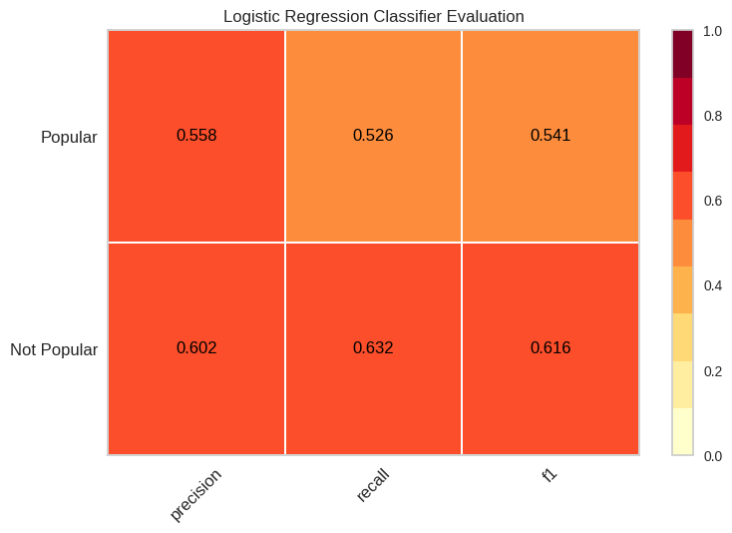
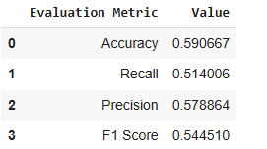
Model 1 - Logistic Regression

Slide 14
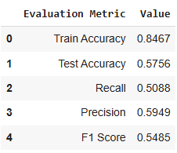
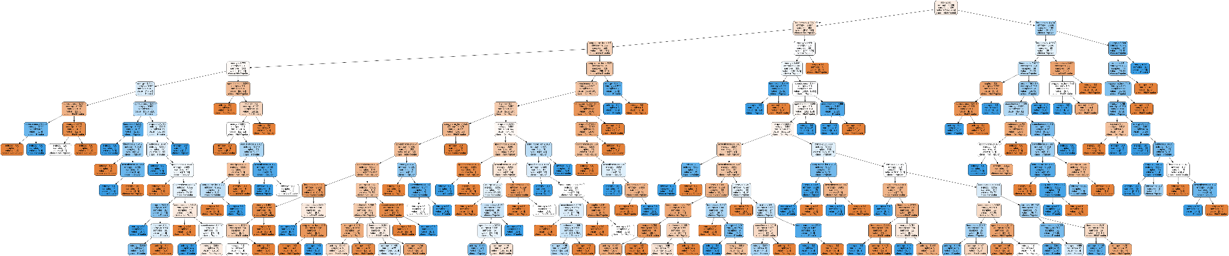
Model 2 - Decision Tree

Slide 15
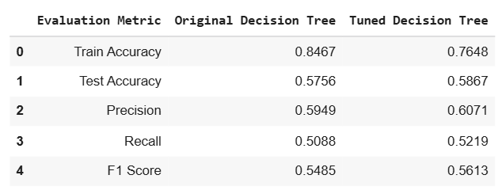
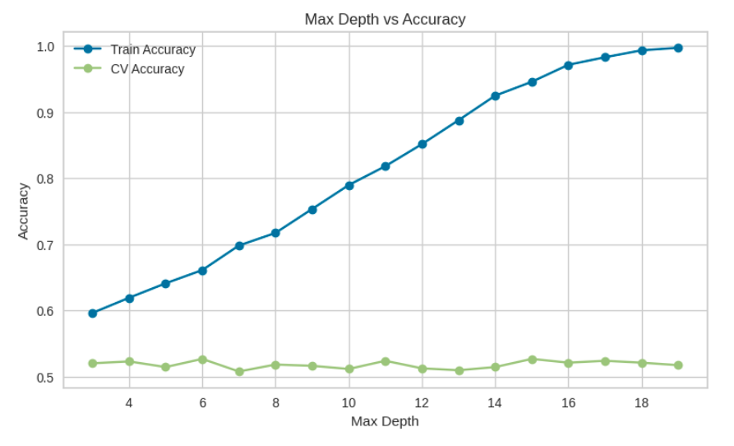
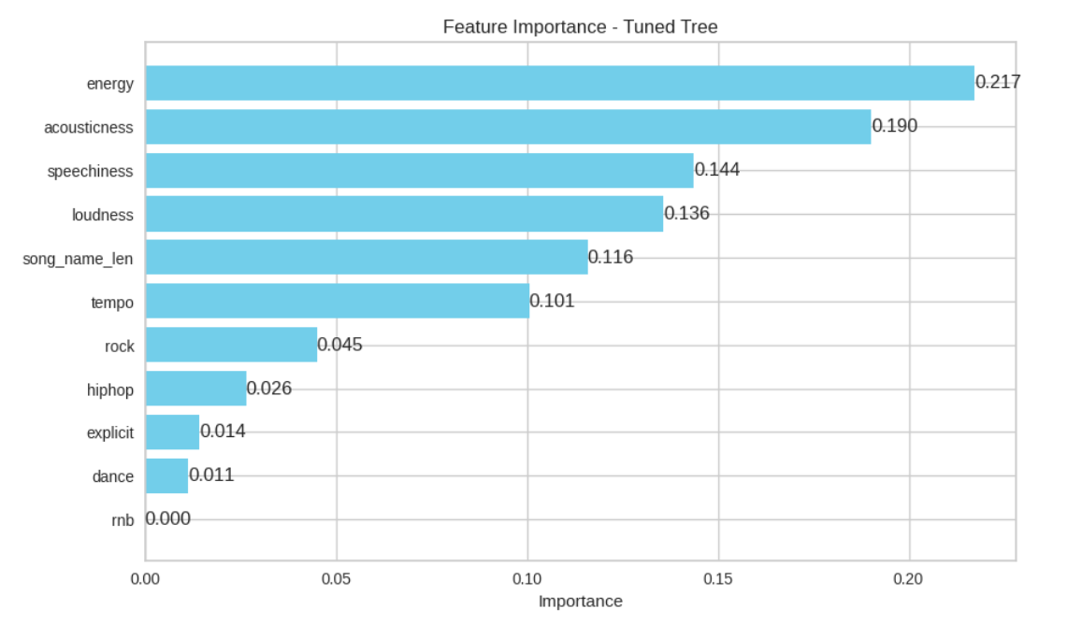
Fine - Tuned Decision Tree
Parameters:
max depth = [4,8,12,16]
min sample split = [20,30,40,50]
Best Parameters:
max depth = 12
min sample split = 3-0

Slide 16
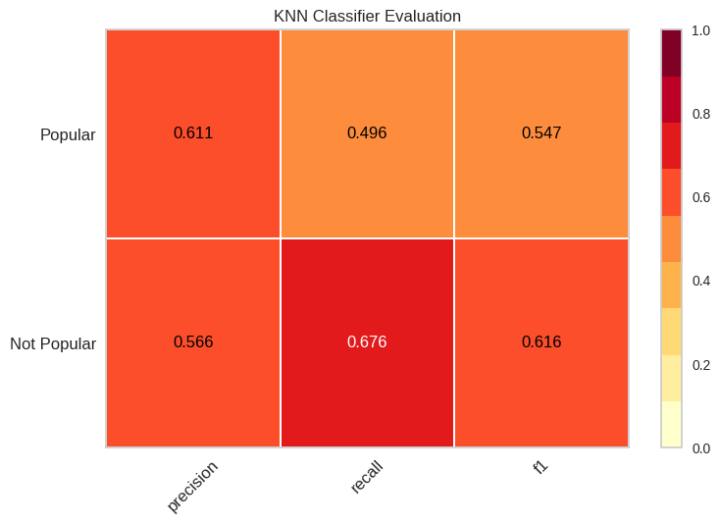
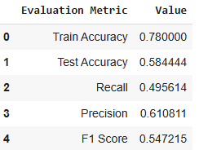
Model 3: K-Nearest Neighbors(Best Model)
Predicting on Training Data

Slide 17
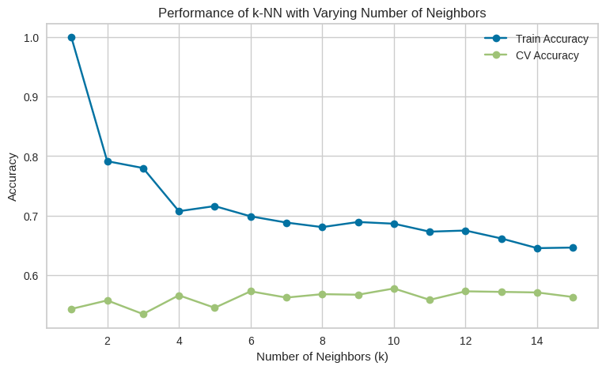
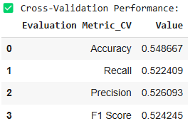
Performed 10-Fold Cross Validation

Slide 18
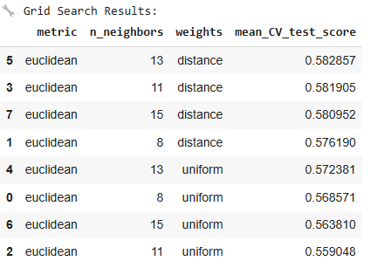
Fine Tuning KNN Model
Parameters Used:
n_neighbors: [8,11,13,15]
Weights: [‘Uniform’, ‘Distance’]
Metric: [‘Euclidean’]

Slide 19
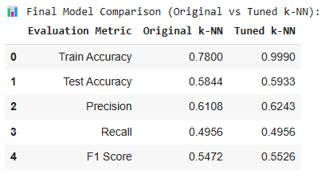
Final Fine Tuned Model
Parameters Used:
n_neighbors: 13
weights: distance
metric: euclidean

Slide 20
Managerial Insights & Recommendations
The best-performing model (tuned KNN) achieves the highest accuracy in predicting song popularity.
Danceability and energy are top indicators of high engagement so focus on these features for playlist curation.
Explicit songs are frequently popular; do not shy away from recommending them.
Pop, hip-hop, and dance genres have a strong link to song success so prioritize these genres, but keep an eye on emerging trends.
1
2
3
Tracks with higher speechiness (e.g., rap, spoken word) and acoustic elements can also attract listeners.
Use predictive insights to select and promote new releases with a higher likelihood of becoming hits.
Regularly revisit and retrain models to capture shifting user preferences.
4
5
6

Slide 21
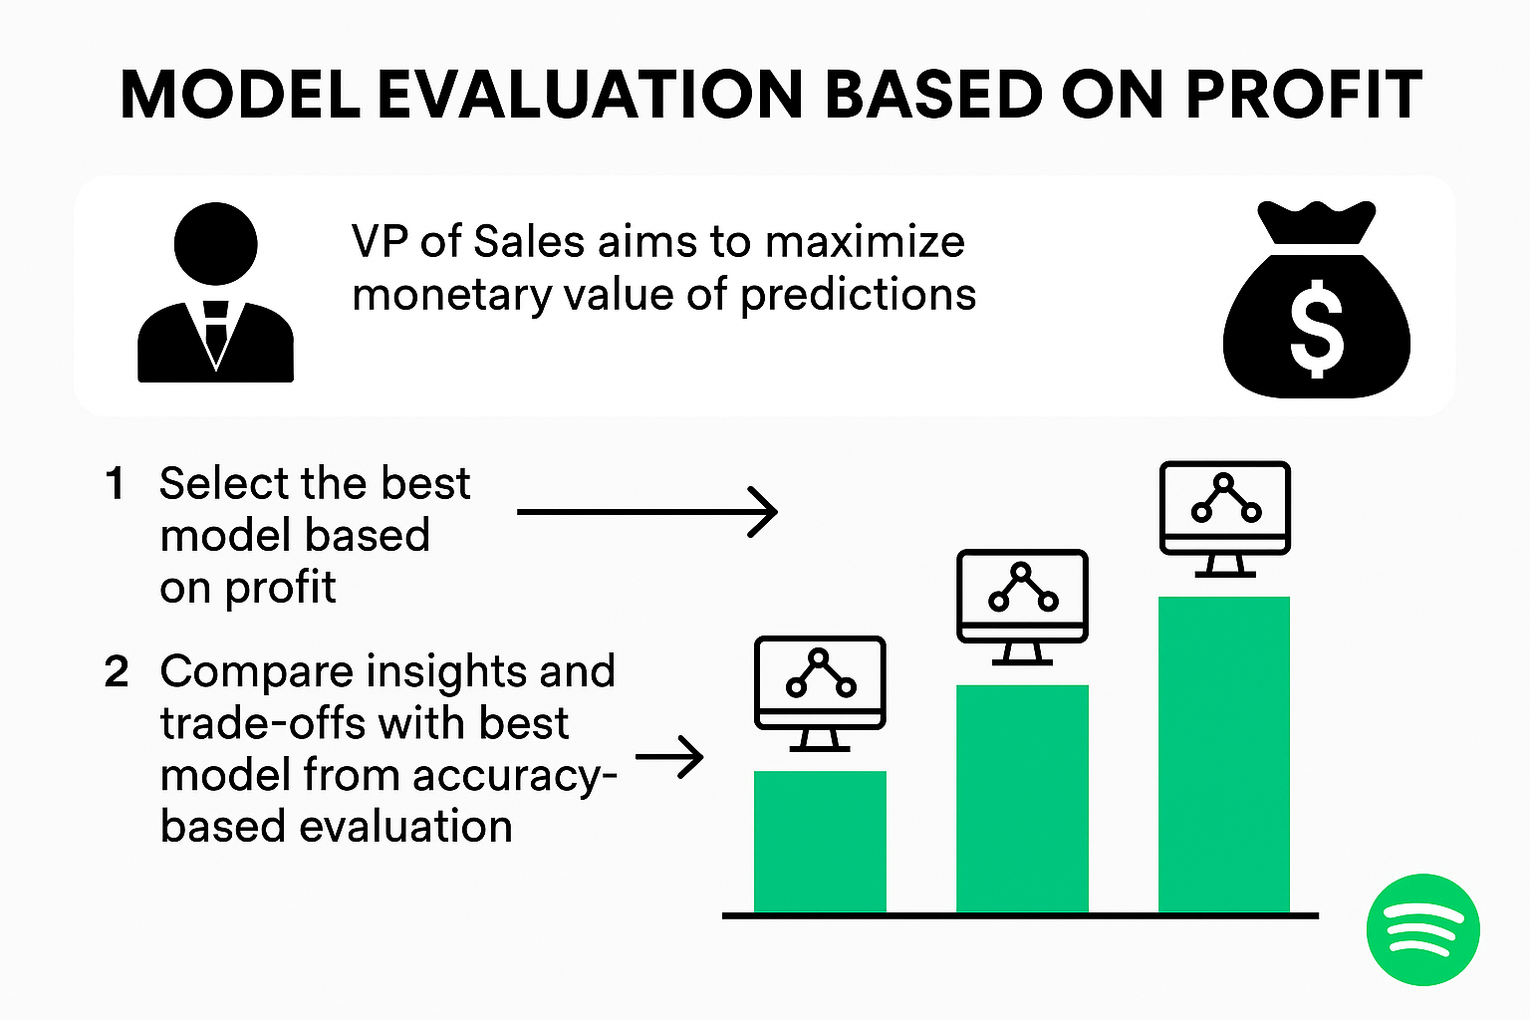
Q2: Profit –Driven Model Evaluation
Business Goal:
Instead of only focusing on accuracy, select the model that maximizes net profit based on the financial value of prediction outcomes.
Cost/Revenue Setup:
True Positive (TP): +$1,000 (Correctly recommending a popular song)
False Positive (FP): -$700 (Over-promoting an unpopular song)
False Negative (FN): -$900 (Missing a popular song)
True Negative (TN): $0 (Correctly ignoring an unpopular song)

Slide 22
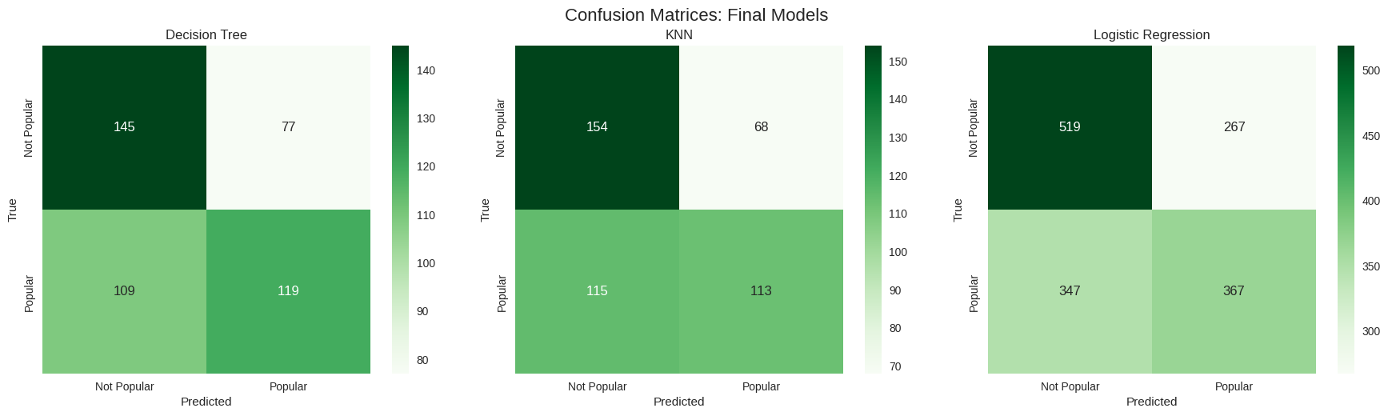
Prediction Performance of the Models
Decision Tree has a good performance with strong true positive and relatively low false negative counts, despite high false positives.
When compared with k-NN, the Decision Tree shows a slightly better recall and true positive count, at the cost of a few more false positives.
Logistic Regression, although the most accurate in terms of raw percentage, produces significantly more costly errors.
This balance of precision and recall makes the Decision Tree the strongest candidate from a business perspective.

Slide 23
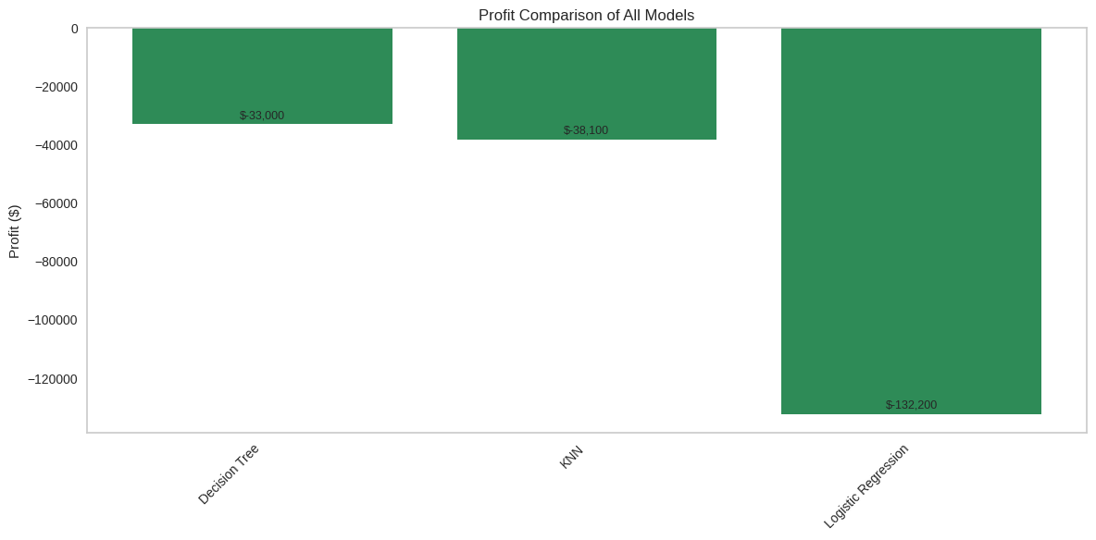
Financial Impact Predictions
Decision Tree delivers the highest profit, reducing loss by over $5,000 compared to k-NN.
It has more true positives and fewer false negatives, minimizing the most costly errors.
Although it has slightly more false positives than k-NN, the additional revenue offsets the cost.
Logistic Regression, despite a high true positive count, suffers from very high FP and FN, leading to significant financial loss.
Overall, the Decision Tree offers the most business-aligned performance for Spotify’s profit-focused strategy.

Slide 24
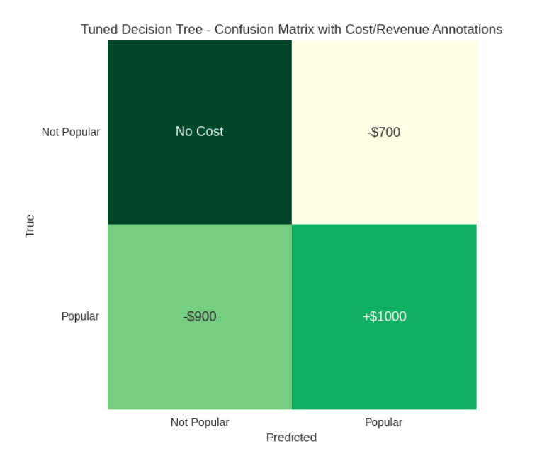
Best Model: Decision Tree
Superior Profitability: Lowest net loss across all models under business-defined cost structure
Strategic Advantage:
Increases high-value predictions (TP)
Decreases most costly errors (FN)
Manages FP within tolerable bounds
Model Strengths:
Reliable generalization across data
Intuitive decision-making structure for stakeholder understanding
Supports Spotify’s cost-efficiency goals without sacrificing predictive quality

Slide 25
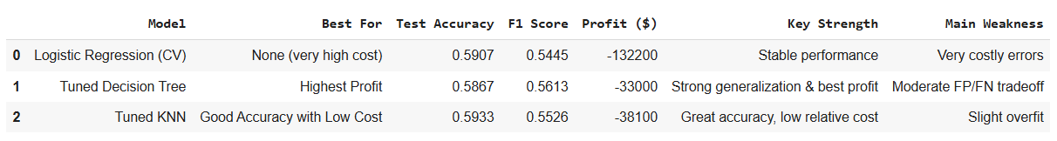
Accuracy vs Profit: A Strategic Decision
Accuracy Rankings:
Tuned k-NN: 59.33%
Logistic Regression: 59.07%
Decision Tree: 58.67%
Profit Rankings:
Tuned Decision Tree (-$33,000)
Tuned k-NN (-$38,100)
Logistic Regression (-$132,200)
A higher accuracy does not always result in better financial outcomes.
Logistic Regression makes too many costly FP and FN errors.
Decision Tree yields better profit by reducing high-penalty mistakes.
Emphasizes the need for business-aligned evaluation metrics.
Spotify should prioritize financial outcomes over pure accuracy or F1 scores.

Slide 26
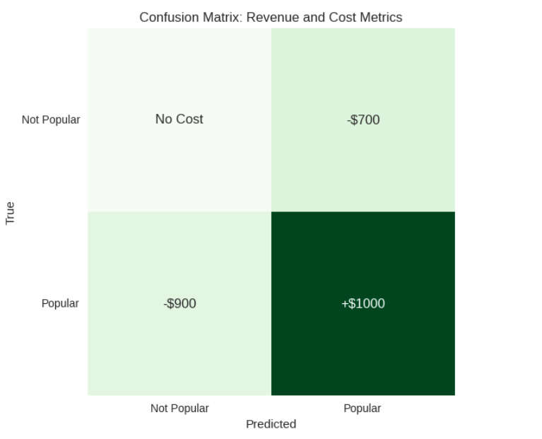
Managing Cost and Maximizing Revenue
False Positives (FP) → Wasted promotions, lower user trust.
False Negatives (FN) → Missed hits, lost revenue, user dissatisfaction.
Costly misclassifications distort recommendation quality and resource use.
Accurate but unprofitable models can misalign with business goals.
Recommendations:
Use cost-sensitive training.
Optimize thresholds based on cost-benefit trade-offs.
Monitor financial impact continuously.
Outcome: Tuned Decision Tree supports smarter, cost-effective recommendations and better user retention.

Slide 27
Final Recommendation
Best Model: Decision Tree
Highest profit (or Least Loss): –$33,000
Offers a practical balance between revenue generation and cost control.
Maintains a favorable F1 score while optimizing for business value.
Implementation Plan:
Integrate the model into Spotify’s recommendation pipeline with a profit-based evaluation routine.
Set up retraining pipelines using up-to-date streaming and user data.
Incorporate real-time dashboards to monitor financial metrics, including profit, misclassification cost, and ROI.
Collaborate with marketing and product teams to fine-tune output sensitivity based on user engagement data.
Strategic Takeaway:
By adopting the Tuned Decision Tree, Spotify aligns model performance directly with business goals.
This approach supports better decision-making in promotional strategies and recommendation accuracy — maximizing both user satisfaction and profitability.

Slide 28
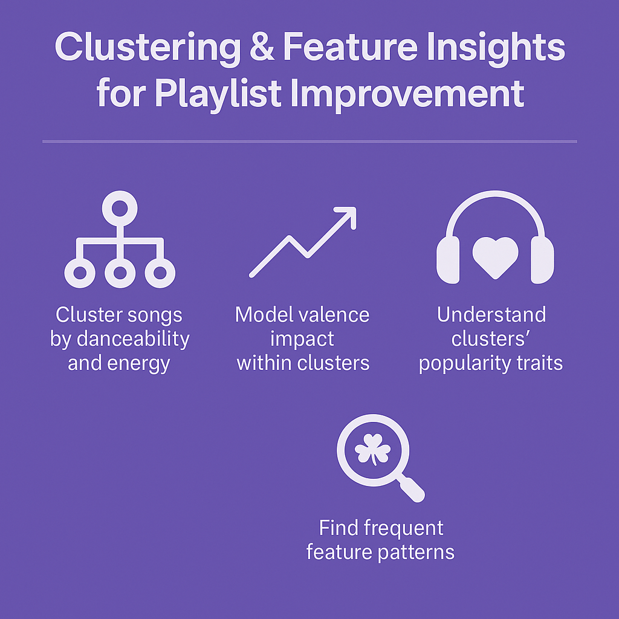
Q3 – Clustering & Valence Impact
Objective:
Explore deeper patterns in the data to improve Spotify’s playlist recommendations by analyzing valence, song clusters, and key feature combinations.
Tasks:
Cluster songs using danceability and energy (optional: include genre)
Within each cluster, model how valence impacts song popularity
Identify and interpret clusters with unique popularity traits
Discover frequent feature patterns tied to high or low popularity
Goal:
Generate actionable insights to build smarter, mood- and genre-aware recommendation systems

Slide 29
Clustering Overview
To understand song similarities and groupings, we clustered songs using danceability and energy as primary features, with genre dummies as optional enrichments.
Primary Features:
Danceability
Energy
Optional Genres taken:
Rock
Hiphop
Dance
rnb
How did we select these features?

Slide 30
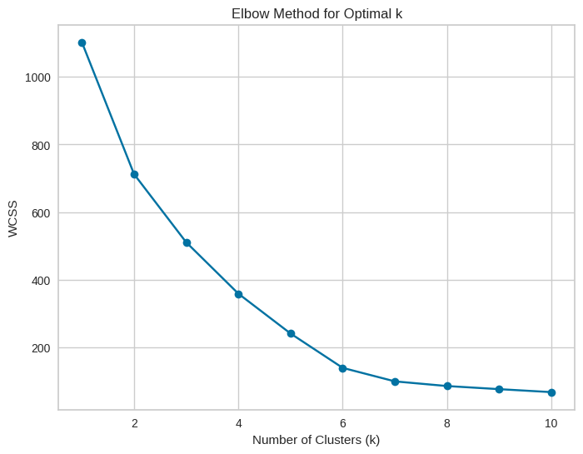
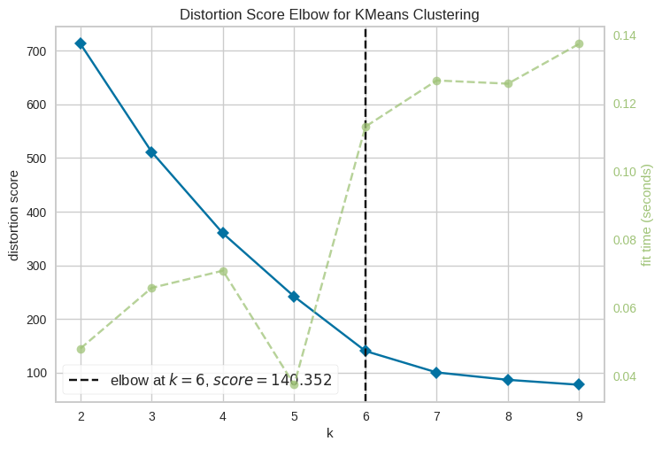
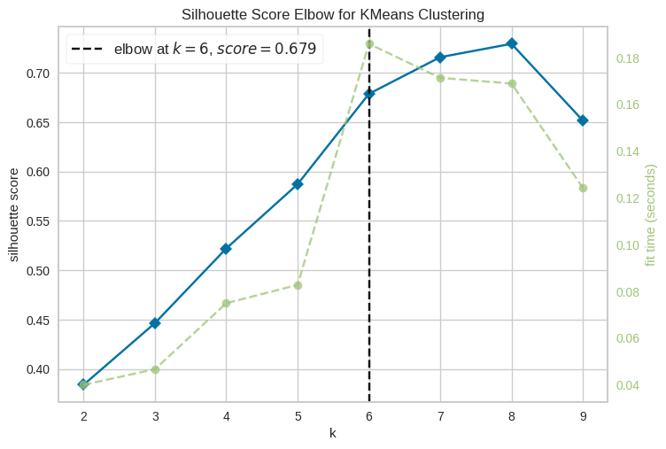
Clustering Method 1: K Means
Optimal k=6

Slide 31
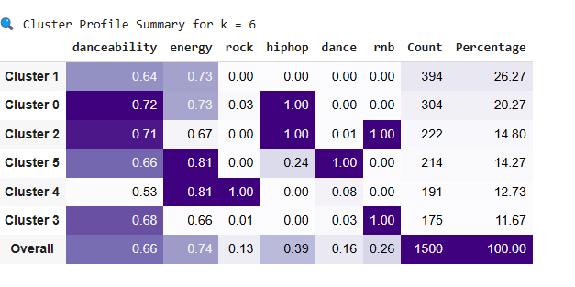
Managerial Insights: K Means
Mainstream and energetic tracks (Clusters 1, 0, 2) account for over 60% of popular songs so we should prioritize these in playlist curation.
Hip-hop, dance, and rnb crossovers perform especially well in energetic clusters.
Pure dance/EDM tracks (Cluster 3) are a smaller, but highly engaged segment, target with specialized playlists.
Continue to promote high-energy, danceable tracks and blend genres to capture broader user tastes.

Slide 32
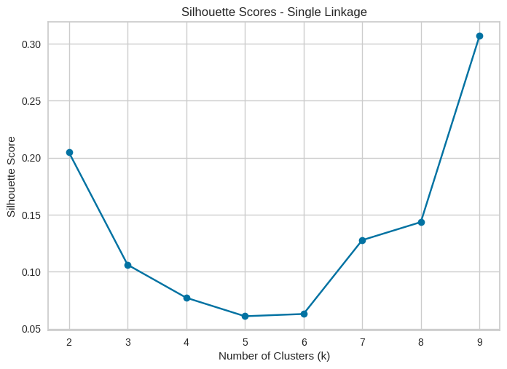
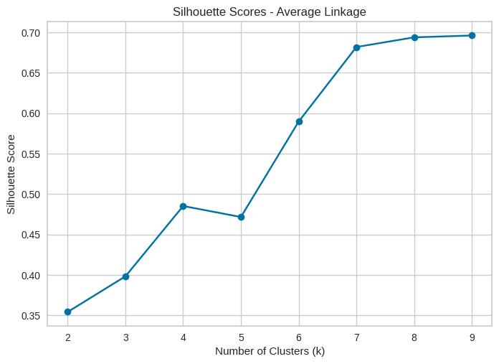
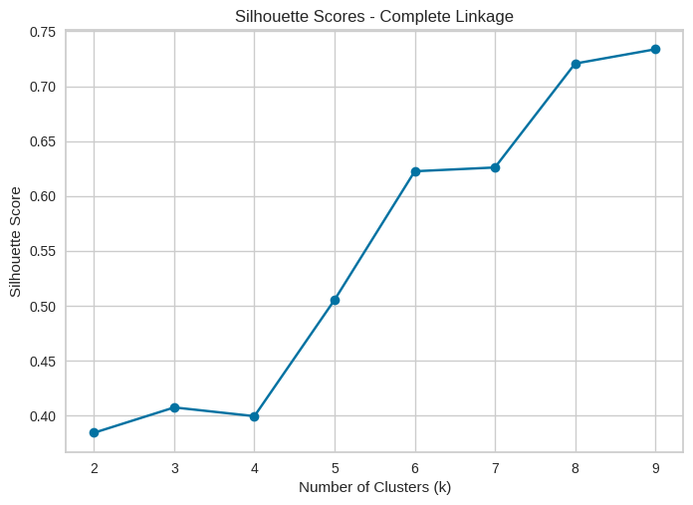
Clustering Method 2: Agglomerative
Silhouette Score: 0.307
Silhouette Score: 0.696
Silhouette Score: 0.734

Slide 33
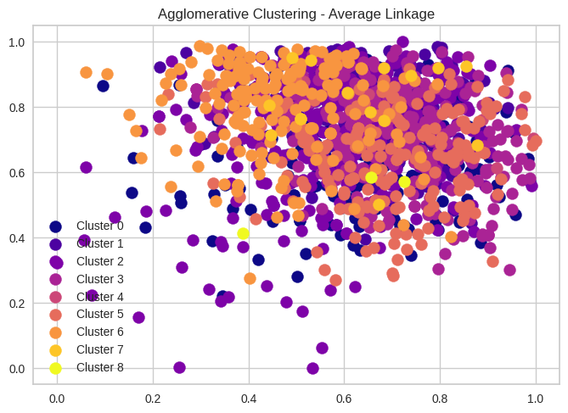
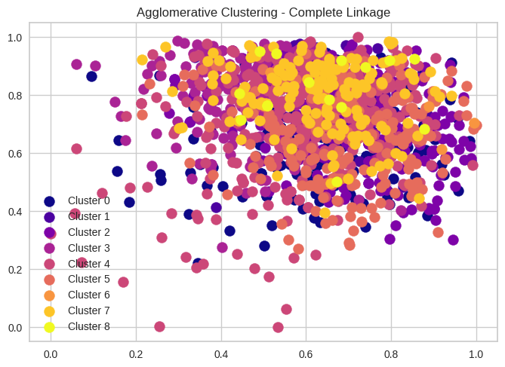
Clustering Method 2: Agglomerative

Slide 34
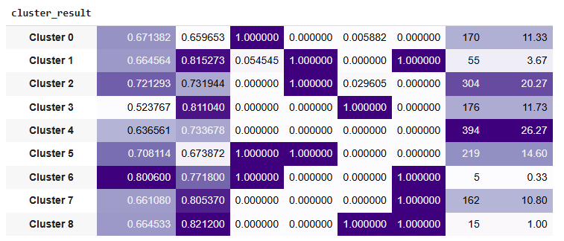
Complete Linkage
The largest clusters (over 70%) feature energetic, danceable tracks and blend hip-hop, R&B, and dance genres, these are ideal for flagship and trending playlists.
Cross-genre tracks consistently lead engagement; promoting these will maximize playlist reach and appeal to a broader audience.
Specialized and niche clusters (such as pure dance, rock, or high-energy R&B) offer valuable opportunities for genre- or mood-specific playlists, deepening user loyalty.
High R&B and hip-hop presence signals potential for expanding genre-focused playlists and attracting dedicated fan bases.
Prioritize upbeat, energetic music across all major playlists to keep listeners engaged.
Regularly revisit and update clustering to reflect evolving user tastes and music trends, ensuring that Spotify’s recommendations stay fresh and relevant.

Slide 35


Clustering Method 3: DBSCAN
Parameters Chosen:
eps value = (0.1,1.0,0.1)
min sample values = range (3,10)
Best eps and min sample Combination:
eps = 0.1
and min samples = 9 or 8

Slide 36

Managerial Insights
Largest clusters (0 & 3, 45%): Energetic, danceable tracks, focus on these for mass-appeal playlists.
Genre-focused clusters (1, 2, 4, 5, 6): Enable targeted playlists for dance, rock, R&B, and hip-hop fans.
Outliers (8%): Great for discovery playlists and showcasing unique or experimental tracks.
Action: Prioritize upbeat, high-energy songs for main playlists; use cluster insights to personalize and diversify Spotify’s recommendations.
We should refresh clustering regularly to keep recommendations aligned with new music trends and shifting listener preferences.

Slide 37

Valence Analysis by CLuster
The effect of valence (musical positivity) on popularity differs by cluster so there is no universal trend.
In some clusters, higher valence (happier songs) increases the chance of popularity (e.g., cluster_kmeans_0, cluster_dbscan_5).
In other clusters, lower valence (moodier songs) is more popular (e.g., cluster_kmeans_2, cluster_agnes_5, cluster_dbscan_4).
Most coefficients are not statistically significant (p-value > 0.05), indicating that valence alone does not strongly predict popularity within most segments.
A few clusters show stronger effects (e.g., agnes_7: strong negative effect with borderline significance), suggesting mood plays a bigger role for specific listener groups.
Overall, valence is not a consistent predictor, its influence depends on the audience and cluster characteristics.
Interpretation

Slide 38
Recommendation & Insights
Tailor playlist strategies by cluster
Some listener segments prefer upbeat, positive tracks, while others engage more with moodier music.
Personalization is key, recommend songs that match each cluster’s mood preference.
Use danceability, energy, and genre alongside mood for more effective recommendations.
Experiment with playlists that focus on high- or low-valence tracks for clusters with strong mood preferences.
Revisit this analysis as listener tastes evolve, adapting playlist curation as new data becomes available.
Avoid a one-size-fits-all approach
Combine valence insights with other features
Test mood-based playlists
Monitor for emerging trends

Slide 39
What Makes a Hit? Insights from Association Rule Mining
Feature Selection
Converted features to binary format using median as a cutoff
Transformed data for rule mining
Mine Patterns
We transformed song features into high/low categories and genres, then mined the dataset to reveal which combinations most often lead to hit songs.

Slide 40

Top Feature Combinations Linked to Song Popularity
High values of loudness, energy, speechiness, and hip-hop are frequently part of hit songs.
Lift values above 2 indicate that these feature sets are at least twice as likely to result in a popular song compared to random chance.
Example:
(loudness_high, speechiness_high) → Popular, energetic, hip-hop tracks are common hits.
(energy_high, hiphop) → Energy and hip-hop together strongly predict success.
Rules with high support and confidence are robust patterns for identifying future hits.

Slide 41

Visualizing the Strongest Hit-Making Patterns
Bars show that combinations involving energy, loudness, speechiness, and hip-hop stand out as the most powerful predictors of popularity.
Strong association rules (high lift) can guide playlist creation and help identify new releases with hit potential.
These insights support prioritizing songs with these “winning” traits in Spotify’s recommendation engine.

Slide 42
Final Recommendations
Prioritize tracks with proven hit features
Design “Hit Predictor” playlists
Enhance genre and mood blending
Personalize user recommendations
1
2
3
4
Elevate songs that are high in loudness, energy, and speechiness, especially within hip-hop and dance genres.
Automatically recommend new releases that match top feature patterns (e.g., high energy + hip-hop) to maximize listener engagement and chart success.
Experiment with playlists that combine energetic, genre-rich features to appeal to a wider audience and encourage musical exploration.
Tailor playlist suggestions by matching users to their preferred combinations of features, increasing relevance and satisfaction.

Slide 43




Meet our team
Sarath Sabu
Riddhi Rungta
Jesin Kandathy Joy
Gauri V Nair
Thank You!

